Slide 1

Chapter 4: Software Design and Architecture Concepts

Slide 2
Contents
1. OBJECT-ORIENTED CONCEPTS
2. INFORMATION HIDING
3. INHERITANCE AND GENERALIZATION/ SPECIALIZATION
4. CONCURRENT PROCESSING
4. DESIGN PATTERNS
5. SOFTWARE ARCHITECTURE AND COMPONENTS
6. SOFTWARE QUALITY ATTRIBUTES

Slide 3
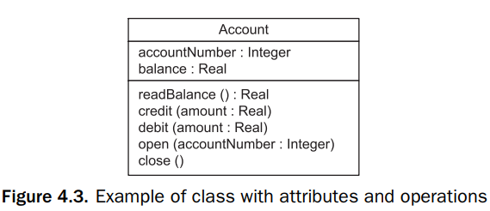
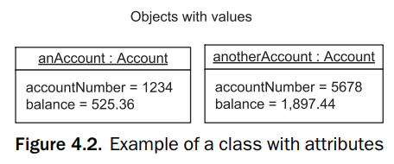
1. Object-oriented concepts
An object is a real-world physical or conceptual entity that provides an understanding of the real world and, hence, forms the basis for a software solution.
A class (also referred to as an object class) is a collection of objects with the same characteristics.
An object is an instance of a class.

Slide 4
2. Information Hiding
Information hiding is used in designing the object, in particular when deciding what information should be visible and what information should be hidden.
The design of an object (or class) is a two-step process – first to design the interface, which is the external view, and then to design the internals. The first step is part of the high-level design, and the second step is part of the detailed design.

Slide 5
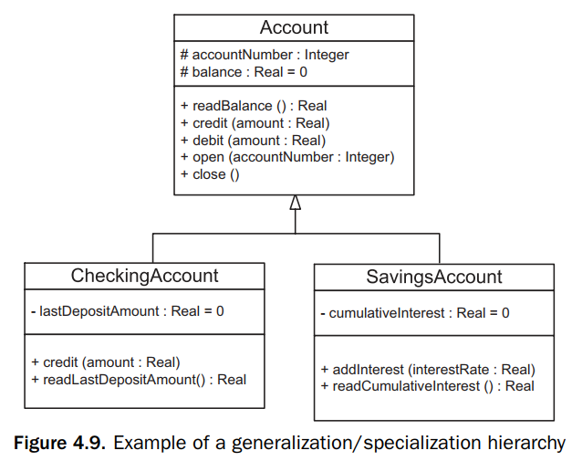
3. Inheritance and generalization/specialization
Inheritance is a useful abstraction mechanism in analysis and design
Inheritance is a classification mechanism that has been widely used in other fields.
Inheritance is a mechanism for sharing and reusing code between classes. A child class inherits the properties (encapsulated data and operations) of a parent class

Slide 6
4. CONCURRENT PROCESSING

Slide 7
4.1. Sequential and Concurrent Applications
A sequential application is a sequential program that consists of passive objects and has only one thread of control. When an object invokes an operation in another object, control is passed from the calling operation to the called operation. When the called operation finishes executing, control is passed back to the calling operation.
In a concurrent application, there are typically several concurrent objects, each with its own thread of control.
Asynchronous message communication is supported, so a concurrent source object can send an asynchronous message to a concurrent destination object and then continue executing, regardless of when the destination object receives the message. If the destination object is busy when the message arrives, the message is buffered for the object.

Slide 8
4.2. Concurrent Objects
A concurrent object (active object, concurrent processes, concurrent tasks, or threads) has its own thread of control and can execute independently of other objects.
Passive objects have operations that are invoked by concurrent objects. Passive objects can invoke operations in other passive objects. A passive object has no thread of control;
A concurrent object represents the execution of a sequential program or a sequential component in a concurrent program.

Slide 9
4.3. Cooperation between Concurrent Objects
In most concurrent applications, concurrent objects must cooperate with each other in order to perform the services required by the application. Three problems commonly arise when concurrent objects cooperate with each other:
The mutual exclusion problem occurs when concurrent objects need to have exclusive access to a resource, such as shared data or a physical device
The synchronization problem occurs when two concurrent objects need to synchronize their operations with each other.
The producer/consumer problem occurs when concurrent objects need to communicate with each other in order to pass data from one concurrent object to another

Slide 10
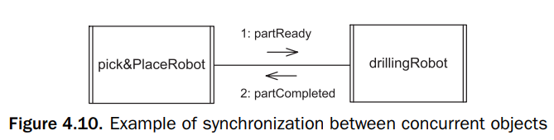
4.4. Synchronization Problem
Event synchronization is used when two tasks need to synchronize their operations without communicating data between the tasks.

Slide 11
4.5. Producer/Consumer Problem
The producer concurrent object produces information, which is then consumed by the consumer concurrent object
In a concurrent system, each concurrent object has its own thread of control and the concurrent objects execute asynchronously.
Message communication between concurrent objects may be asynchronous or synchronous.

Slide 12
4.6. Asynchronous Message Communication
With asynchronous message communication(loosely coupled message communication), the producer sends a message to the consumer and either does not need a response or has other functions to perform before receiving a response.
The producer sends a message and continues without waiting for a response.
The consumer receives the message. As the producer and consumer concurrent objects proceed at different speeds, a first-in-first-out (FIFO) message queue can build up between producer and consumer. If there is no message available when the consumer requests one, the consumer is suspended

Slide 13
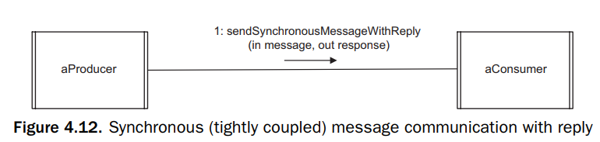
4.7. Synchronous Message Communication
In the case of synchronous message communication with reply(tightly coupled message communication with reply), the producer sends a message to the consumer and then waits for a reply. When the message arrives, the consumer accepts the message, processes it, generates a reply, and then sends the reply. The producer and consumer then both continue.

Slide 14
5. Design patterns
A design pattern describes a recurring design problem to be solved, a solution to the problem, and the context in which that solution works. The main kinds of reusable patterns are as follows:
﻿Design patterns: a ﻿small group of collaborating objects
﻿Architectural patterns: ﻿larger-grained (higher level) than design patterns, ﻿structure of major subsystems of a system
﻿Analysis patterns: ﻿recurring patterns found in object-oriented analysis and described them with static models, expressed in class diagrams
﻿Product line–specific patterns: ﻿concentrating on a specific application domain, provide more ﻿tailored domain-specific solutions
﻿Idioms: ﻿low-level patterns that are specific to a given programming language and describe implementation solutions to a problem that use the features of the language (Java, C++,…)

Slide 15
6. Software architecture and components
A software architecture separates the overall structure of the system, in terms of components and their interconnections, from the internal details of the individual components.
A component is a self-contained, usually concurrent, object with a well-defined interface that is capable of being used in applications different from that for which it was originally designed.
A connector encapsulates the interconnection protocol between two or more components.
Different kinds of message communication between components include asynchronous (loosely coupled) and synchronous (tightly coupled). The interaction protocols for each of these types of communication can be encapsulated in a connector.

Slide 16
7. Software quality attributes
The quality attributes are addressed and evaluated at the time the software architecture is developed, and can have a profound effect on the quality of a software product.
Maintainability. The extent to which software is capable of being changed after deployment.
Modifiability. The extent to which software is capable of being modified during and after initial development.
Testability. The extent to which software is capable of being tested.
Traceability. The extent to which products of each phase can be traced back to products of previous phases.
Scalability. The extent to which the system is capable growing after its initial deployment.
Reusability. The extent to which software is capable of being reused.
Performance. The extent to which the system meets its performance goals, such as throughput and response times.
Security. The extent to which the system is resistant to security threats.
Availability. The extent to which the system is capable of addressing system failure

